Slide 1
Network Layer:
Internet Protocol

Slide 2

Figure Network layer in an internetwork

Slide 3

Note
Communication at the network layer in the Internet is connectionless.

Slide 4
IPv4
The Internet Protocol version 4 (IPv4) is the delivery mechanism used by the TCP/IP protocols.
Internet Protocol is an unreliable, connectionless network layer protocol. Packets are independent and can follow different paths, reach out-of-order at destination.
Internet Protocol does its best to deliver the packet towards destination (best-effort delivery).

Slide 5

Figure Position of IPv4 in TCP/IP protocol suite

Slide 6

Figure IPv4 datagram format

Slide 7
Field Purpose
Vers IP version number
Len Length of IP header (4 octet units)
TOS Type of Service
T. Length Length of entire datagram (octets)
Ident. IP datagram ID (for frag/reassembly)
Flags Don’t/More fragments
Frag Off Fragment Offset
Field Purpose
TTL Time To Live - Max # of hops
Protocol Higher level protocol (1=ICMP,
6=TCP, 17=UDP)
Checksum Checksum for the IP header
Source IP Originator’s Internet Address
Dest. IP Final Destination Internet Address
Options Source route, time stamp, etc.
Data... Higher level protocol data

Slide 8

Figure Service type or differentiated services

Slide 9
Note
The precedence subfield was part of version 4, but never used.

Slide 10

Table Types of service

Slide 11

Table Default types of service

Slide 12

Table Values for codepoints

Slide 13
Note
The total length field defines the total length of the datagram including the header.

Slide 14

Figure Protocol field and encapsulated data

Slide 15

Table Protocol values

Slide 16
Example
In an IPv4 packet, the value of HLEN is 1000 in binary. How many bytes of options are being carried by this packet?
Solution
The HLEN value is 8, which means the total number of bytes in the header is 8 × 4, or 32 bytes. The first 20 bytes are the base header, the next 12 bytes are the options.

Slide 17
Example
In an IPv4 packet, the value of HLEN is 5, and the value of the total length field is 0x0028. How many bytes of data are being carried by this packet?
Solution
The HLEN value is 5, which means the total number of bytes in the header is 5 × 4, or 20 bytes (no options). The total length is 40 bytes, which means the packet is carrying 20 bytes of data (40 − 20).

Slide 18

Figure Maximum transfer unit (MTU)

Slide 19

Figure Flags used in fragmentation

Slide 20

Figure Fragmentation example

Slide 21

Figure Detailed fragmentation example

Slide 22
Example
A packet has arrived with an M bit value of 0. Is this the first fragment, the last fragment, or a middle fragment? Do we know if the packet was fragmented?
Solution
If the M bit is 0, it means that there are no more fragments; the fragment is the last one. However, we cannot say if the original packet was fragmented or not. A non-fragmented packet is considered the last fragment.

Slide 23
Example
A packet has arrived with an M bit value of 1. Is this the first fragment, the last fragment, or a middle fragment? Do we know if the packet was fragmented?
Solution
If the M bit is 1, it means that there is at least one more fragment. This fragment can be the first one or a middle one, but not the last one. We don’t know if it is the first one or a middle one; we need more information (the value of the fragmentation offset).
Notes:
00

Slide 24
ICMP
The IP protocol has no error-reporting or error-correcting mechanism. The IP protocol also lacks a mechanism for host and management queries. The Internet Control Message Protocol (ICMP) has been designed to compensate for the above two deficiencies. It is a companion to the IP protocol.

Slide 25

Figure General format of ICMP messages

Slide 26
Note
ICMP always reports error messages to the original source.

Slide 27
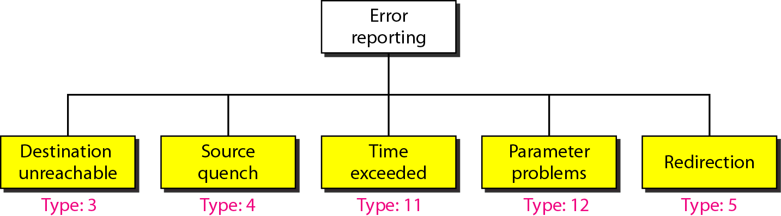
Figure Error-reporting messages

Slide 28
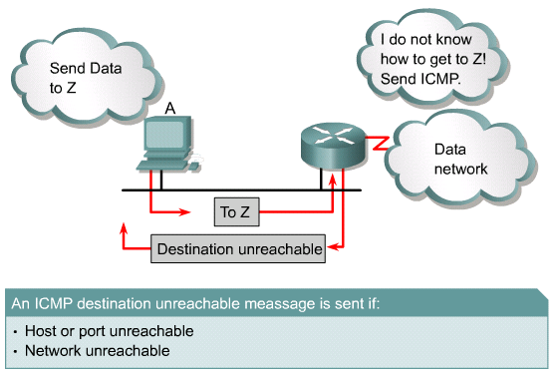
Figure Network/Destination Unreachable

Slide 29
Source Quench
Dropped packets occur when there is too much congestion on a network.
ICMP source-quench messages are used to reduce the amount of data lost.
The source-quench message asks senders to reduce the rate at which they are transmitting packets.
Most Cisco routers do not send source-quench messages by default, because the source-quench message may itself add to the network congestion.

Slide 30
Time Exceeded
The limitations of the routing protocol can result in destinations being unreachable.
For example, RIP has a limit on the distance a certain routing information is allowed to travel.
The hop limit of RIP is 15, which means that the packet will only be allowed to pass through 15 routers.
As each router processes the datagram, it decreases the time-to-live (TTL) value by one.
When the TTL of the datagram value reaches zero, the packet is discarded.
ICMP uses a time exceeded message to notify the source device that the TTL of the datagram has been exceeded.

Slide 31
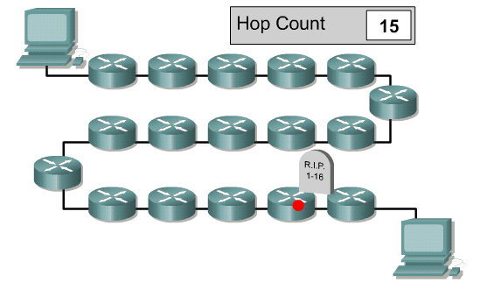
Time Exceeded

Slide 32
Parameter Problems
Devices that process datagrams may not be able to forward a datagram due to some type of error in the header.
This error does not relate to the state of the destination host or network but still prevents the datagram from being processed and delivered.
In this case, an ICMP type 12 parameter problem message is sent to the source of the datagram.

Slide 33
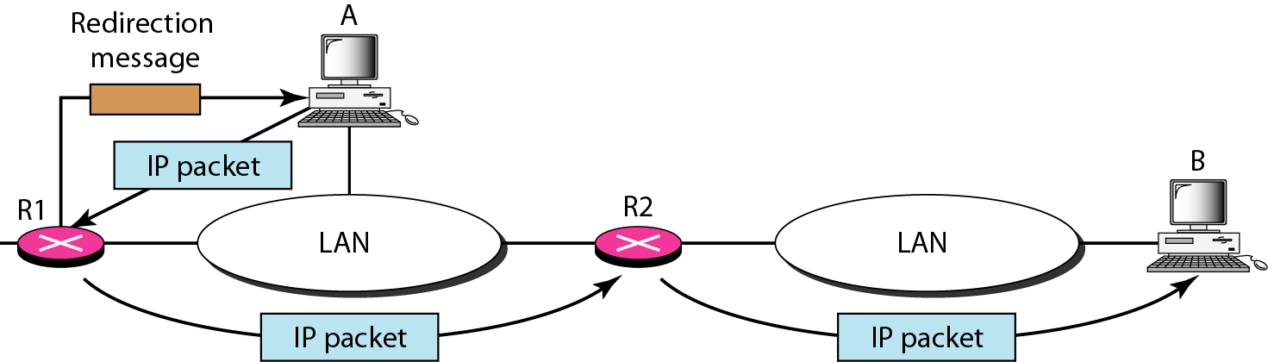
Figure Redirection concept

Slide 34
Note
Important points about ICMP error messages:
❏ No ICMP error message will be generated in
response to a datagram carrying an ICMP error
message.
❏ No ICMP error message will be generated for a
fragmented datagram that is not the first fragment.
❏ No ICMP error message will be generated for a
datagram having a multicast address.
❏ No ICMP error message will be generated for a
datagram having a special address such as
127.0.0.0 or 0.0.0.0.

Slide 35

Figure Query messages

Slide 36
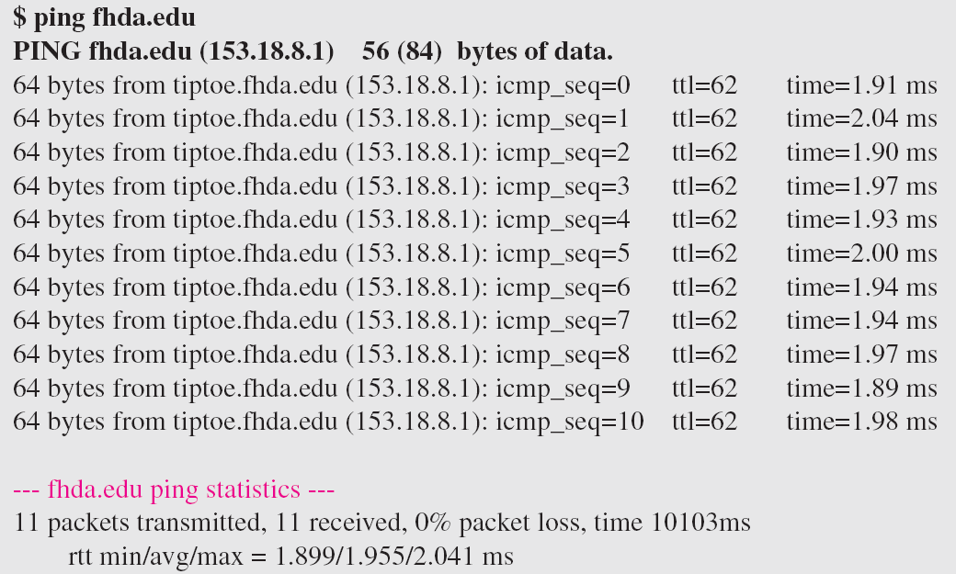
Example

Slide 37
Timestamp request and reply
Hosts on different networks who are trying to communicate using software that requires time synchronization can sometimes encounter problems.
The ICMP timestamp message type is designed to help alleviate this problem.
The ICMP timestamp request message allows a host to ask for the current time according to the remote host.
The remote host uses an ICMP timestamp reply message to respond to the request.

Slide 38
Address mask request and reply
If a host does not know the subnet mask, it may send an address mask request to the local router.
If the address of the router is known, this request may be sent directly to the router. Otherwise, the request will be broadcast.
When the router receives the request, it will respond with an address mask reply.

Slide 39
Router Solicitation and advertisement
A host generates an ICMP router solicitation message in response to a missing default gateway.
This message is sent via multicast and it is the first step in the router discovery process.
A local router will respond with a router advertisement identifying the default gateway for the local host.

Slide 40
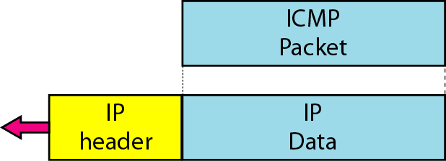
Figure Encapsulation of ICMP query messages

Slide 41
Network Layer:
Routing Information Protocol (RIP)

Slide 42
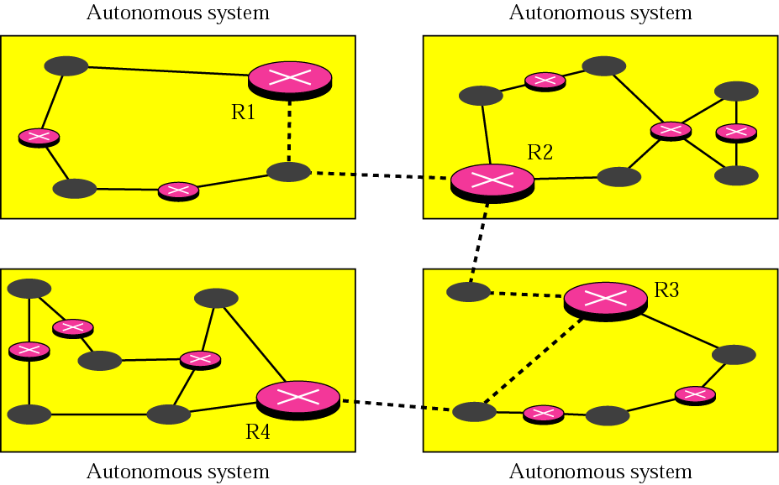
Intra-and Interdomain Routing
An internet is divided into autonomous systems. An autonomous system (AS) is a group of networks and routers under the authority of a single administration
Routing inside an autonomous system is referred to as intradomain routing
Routing between autonomous system is referred to as interdomain routing

Slide 43
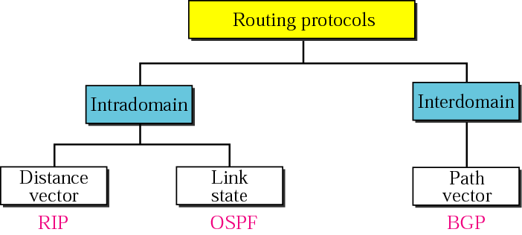
Popular Routing Protocols
Routing Information Protocol (RIP) is the implementation of the distance vector protocol
Open Shortest Path First (OSPF) is the implementation of the link state protocol
Border Gateway Protocol (BGP) is the implementation of the path vector protocol

Slide 44
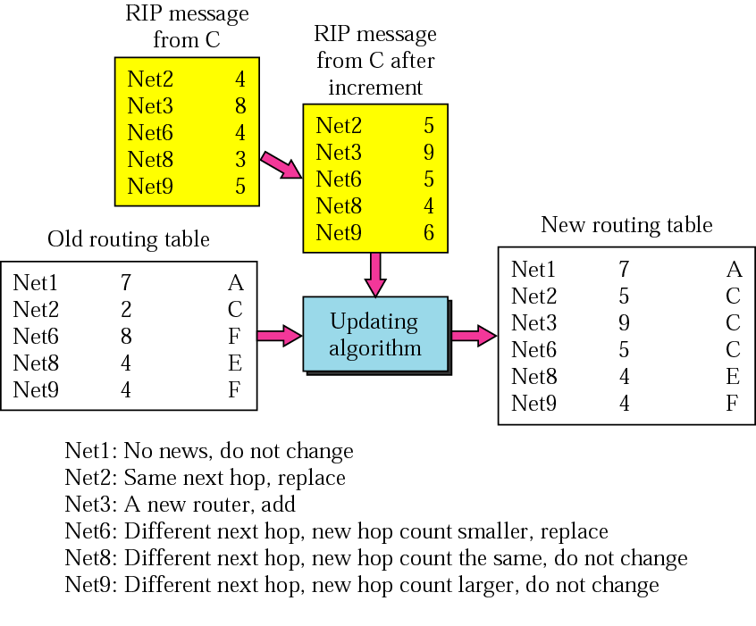
Routing Information Protocol
Receive a RIP message (a response)
Add one hop for each advertised dest
Repeat
  If (dest not in routing table)
    Add the advertised info to the table
  Else
    If (next-hop is the same)
      Replace with the advertised one
    Else
      If (advertised hop count < one in the table)
      Replace entry in the routing table
Return
Distance vector algorithm (Bellman-Ford)
  Sharing knowledge about the entire AS
  Shares only with neighbors
  Shares at regular intervals (different from DVA)

Slide 45
When to Share
The table is sent both periodically and when there is a change in the table
Periodic Update. A node sends its routing table, normally every 30 seconds, in a periodic update. The period depends on the protocol that is using distance vector routing
Triggered Update. A node sends its 2-column routing table to its neighbors any time there is a change in its routing table. This is called a triggered update. The change can result from the following.
  A node receive a table from a neighbor resulting in changes in its own table after updating
  A node detects some failure in the neighboring links which results in a distance change to infinity

Slide 46
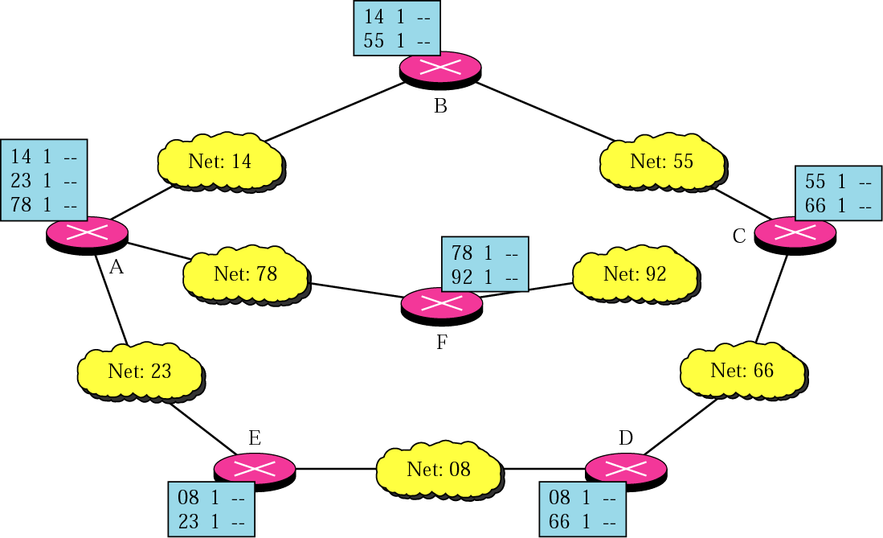
Initial routing tables in a small
autonomous system

Slide 47
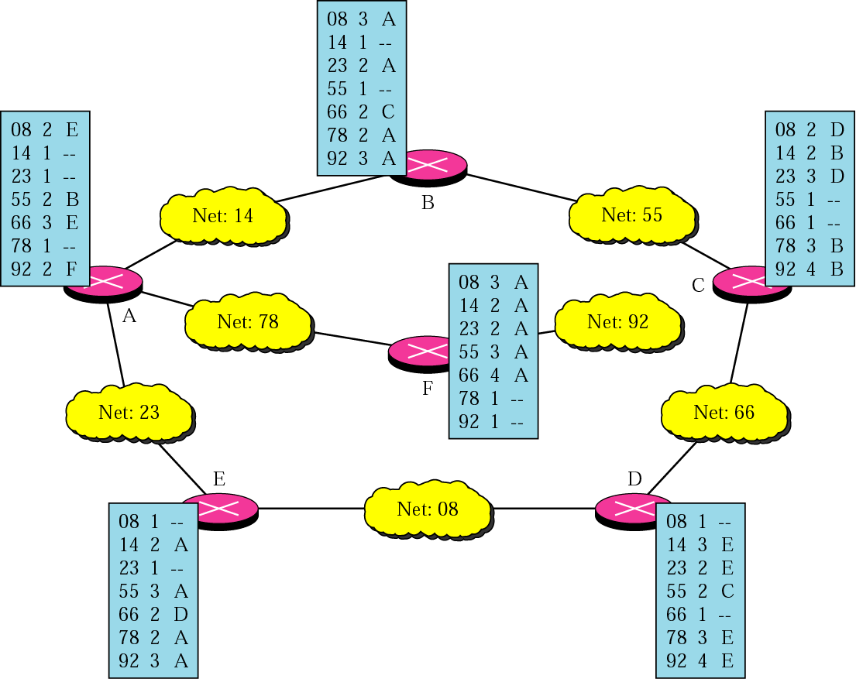
Final routing tables for the previous figure

